Slide 1
3D Chaos‑Enhanced Block‑Permutation & Diffusions

Slide 2
Novel Method for Secure Image Encryption
Introduction
Background
3D Chaotic Key Generation
Row Rotation (X sequence)
Column Rotation (Y sequence)
Intra‑Block Pixel Permutation
XOR Diffusion (Z sequence)
Results & Discussion
Visual Example
Conclusion & Future Work
Q&A / Closing

Slide 3
Introduction
Goal of Encryption: Securely encrypt 256×256 grayscale images with minimal overhead ensures both confidentiality and performance.
AES/DES Limitations: Though AES and DES offer security, their processing speed is a significant drawback in practical applications.
Enhanced Chaos Design: Combining 3D chaotic key streams with permutation and XOR diffusion remedies conventional chaotic encryption weaknesses.

Slide 4
Background
ECB Mode Vulnerabilities: In ECB mode, identical plaintext blocks yield identical ciphertext, enabling visual structure leakage in images.
Row/Column Chaos Permutation: Utilizes chaotic sequences X and Y to shuffle rows and columns, enhancing encryption complexity significantly.
Pixel-Level Chaos Permutation: Employs a singular chaotic stream for pixel reordering, effectively generating confusion without adequate diffusion.

Slide 5
3D Chaotic Key Generation
3D Logistic Map Keys: Utilizes parameters a=0.0125, b=0.0157, c=3.7700 for generating chaotic key streams efficiently.
Initial Seed Values: Seeds x₀, y₀, z₀ are randomly selected within (0,1) to enhance unpredictability of key generation.
Burn-in Iterations: Conducts a burn-in period of 1,000 iterations to stabilize key generation outputs before encryption.

Slide 6
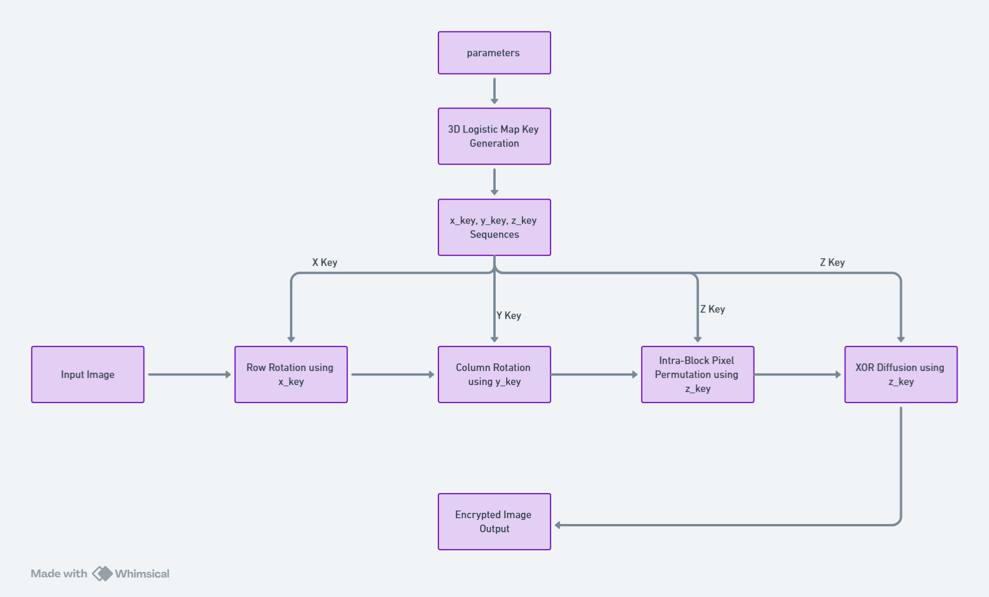

Slide 7
Row Rotation (X sequence)
Row Rotation Process: Each row i is rotated based on x_key[i] % 256, facilitating both left and right shifts.
Even and Odd Shifts: Even-indexed rows undergo right shifts while odd-indexed rows experience left shifts for balance.

Slide 8
Column Rotation (Y sequence)
Column Transposition Mechanism: Transposes the image, applying row logic to rotate columns using y_key[j] % 256 shifting technique.
Shift Directionality: Even-indexed columns are shifted upwards while odd ones shift downwards, enhancing encryption complexity effectively.

Slide 9
Intra‑Block Pixel Permutation
Block Division Methodology: Image segmented into 256 blocks of 16×16 pixels, facilitating localized processing of permutation strategies.
Pixel Permutation Process: For each block, z_key enables sorting and permuting pixels, enhancing distribution and encryption security.

Slide 10

XOR Diffusion (Z sequence)
Reshaping z_key: Transforming z_key into a structured 256×256 matrix optimizes pixel-wise operations for encryption efficiency.
Pixel-wise XOR Operations: XOR operations between permuted images and z_key ensure significant diffusion, contributing to enhanced security dynamics.
Self-inverse Property: The self-inverse nature of XOR guarantees reversible transformations, critical for secure decryption processes.
Generated on AIDOCMAKER.COM

Slide 11
Results & Discussion
Entropy Measurement: Entropy measured at approximately 7.997 indicates high randomness essential for robust encryption efficacy.
NPCR Analysis: NPCR value of approximately 99.6% suggests substantial pixel change, confirming effective ciphertext sensitivity to plaintext variations.
Time Efficiency: Encryption and decryption times of about 0.02s and 0.017s demonstrate the algorithm's practicality for real-time applications.

Slide 12


Visual Example
Original Image: Displayed image patch representing the initial state before any encryption processes are applied.
Row/Column Rotation: Demonstrates the transformation from original to rotated state, showcasing initial change during encryption.
Final Cipher Image: Reveals the end result after complete encryption, highlighting effective security through chaotic key use.

Slide 13

Original Image
Encrypted Image
Decrypted Image

Slide 14
Conclusion & Future Work
Recap of Encryption Method: Utilizes chaotic key streams with permutation and diffusion techniques, enhancing security beyond traditional approaches.
Advantages Over Traditional Methods: This method surpasses AES/DES by combining speed, security, and adaptability to varied data types.
Future Work Directions: Exploring hardware acceleration, adaptivity for color/video formats, and block size variations enhances versatility.

Slide 15
Q&A / Closing
Thank You for Attention: I sincerely appreciate your attention and engagement in today’s presentation on encryption innovations.
Open for Questions: I invite any questions or discussions regarding the points raised during this presentation.
Further Discussions Welcome: Feel free to approach me after the session for more in-depth discussions on this topic.

